Slide 1
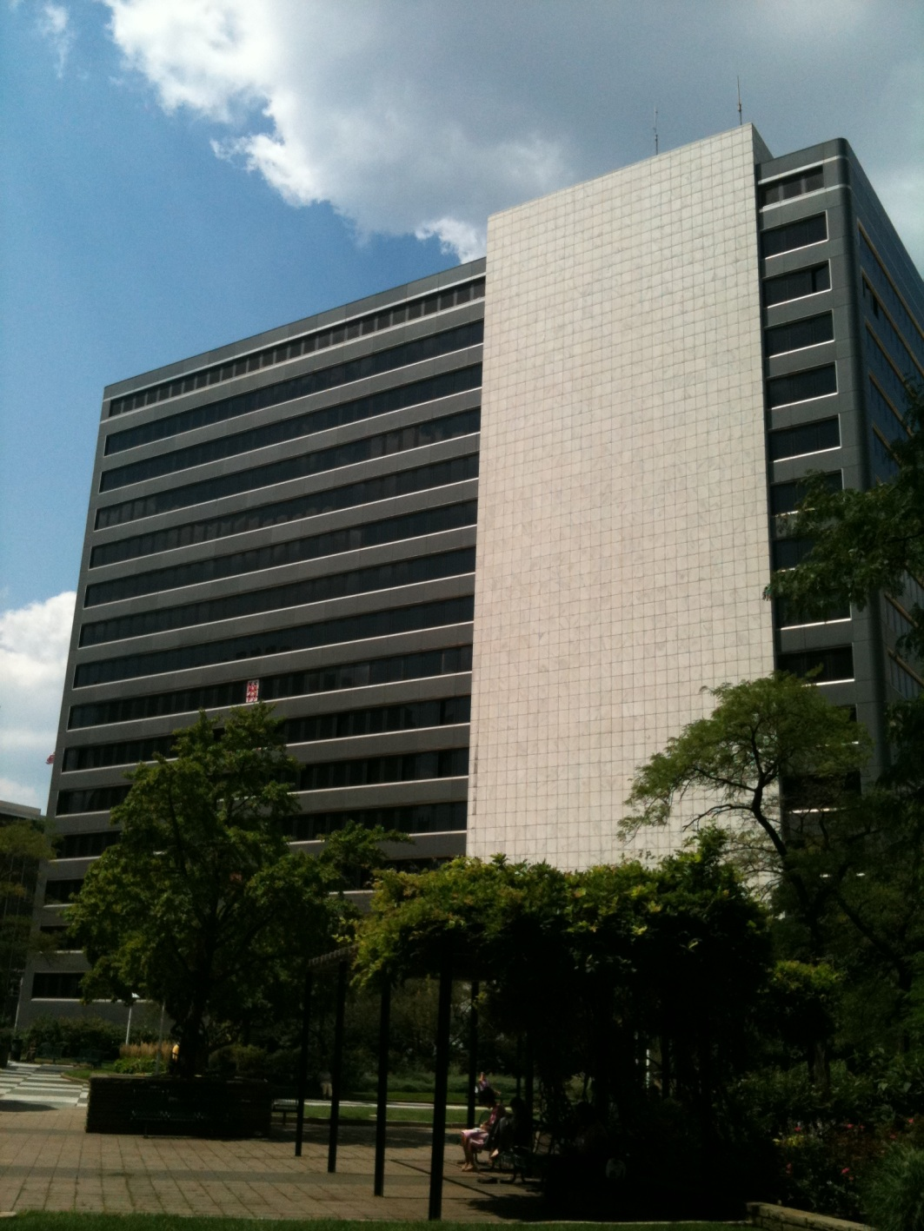
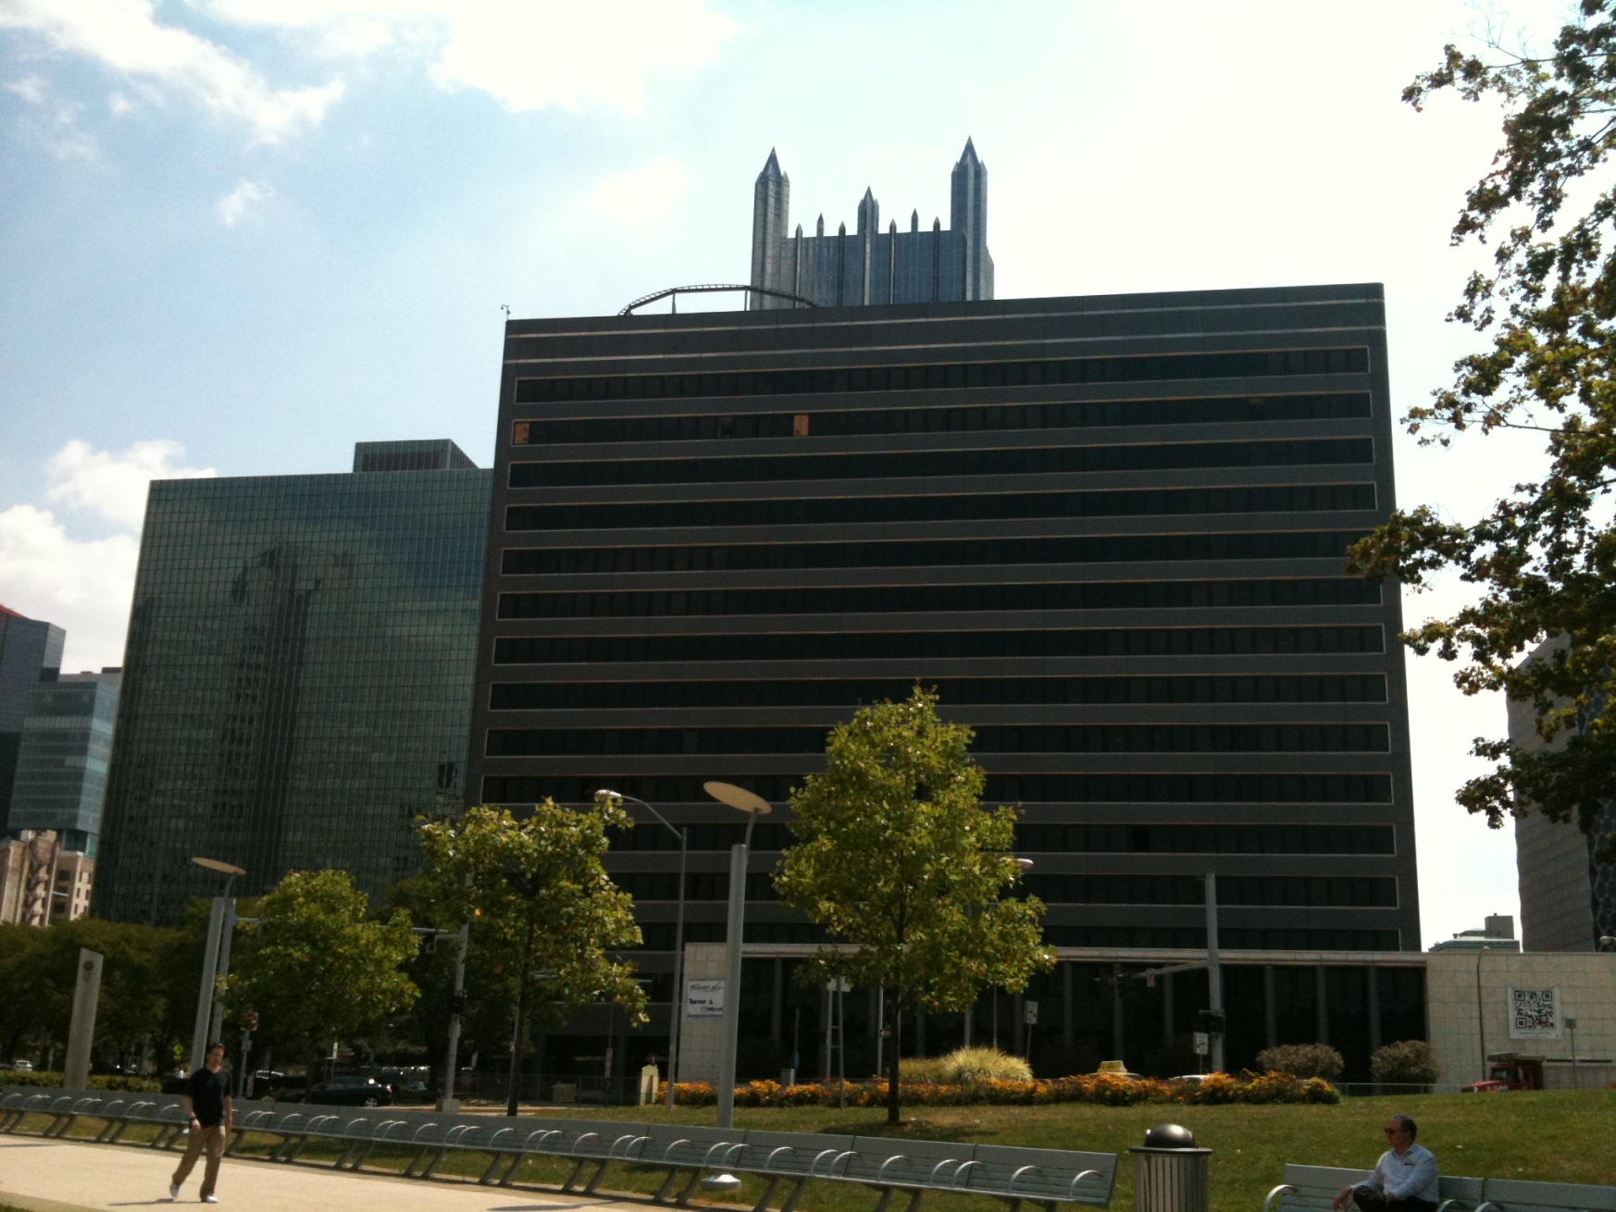
River Vue Apartments
Laura Pica – Mechanical Option
Adviser – Stephen Treado
Senior Thesis Program 2011-2012
Department of Architectural Engineering
Color photo taken by Laura Pica August 2011
Color photo taken by Laura Pica August 2011

Slide 2
Schedule
Building Overview
Existing Mechanical System
Mechanical Depth Design
Demand Control Ventilation
Mechanical Design Alternatives
Energy & Cost Analyses
Breadth 1 – Photovoltaic Array Study
Breadth 2 – CM Study
Conclusions
Acknowledgements

Slide 3
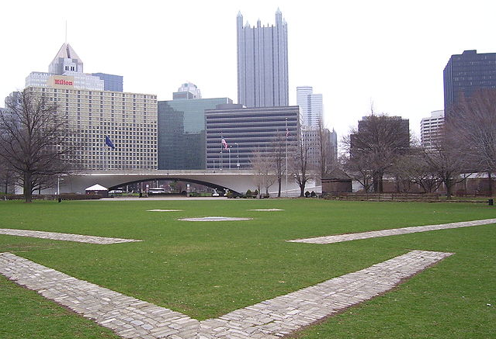
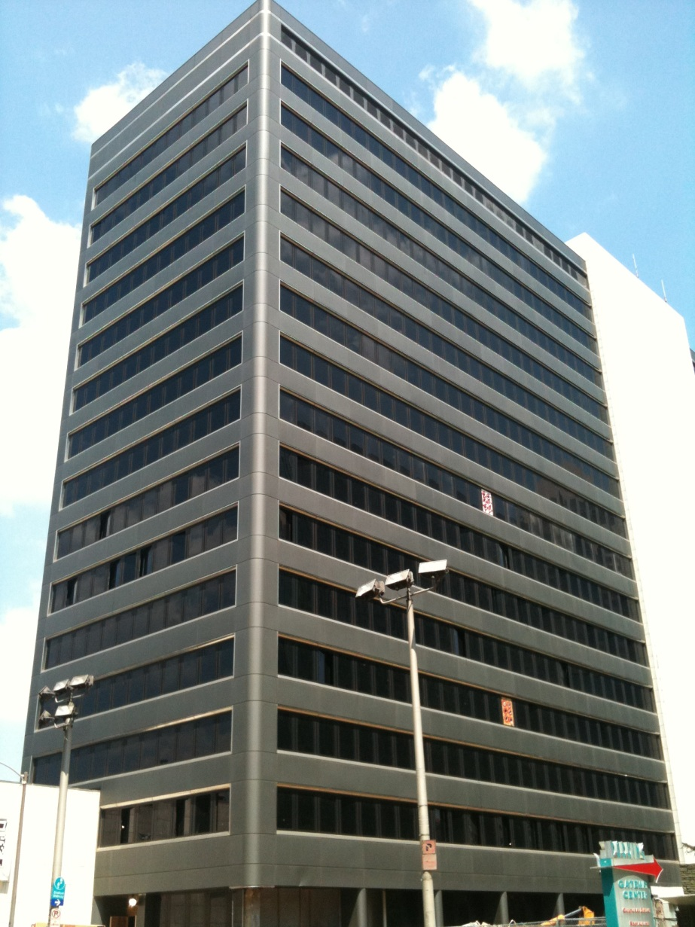
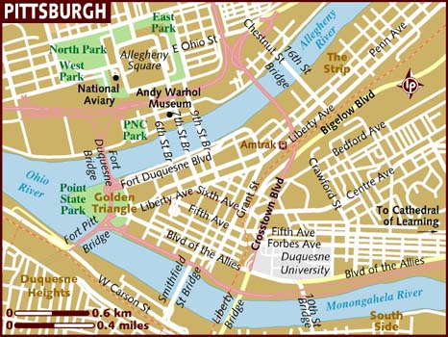
Schedule
Building Overview
Existing Mechanical System
Mechanical Depth Design
Demand Control Ventilation
Mechanical Design Alternatives
Energy & Cost Analyses
Photo courtesy www.wikipedia.com
Breadth 1 – Photovoltaic Array Study
Breadth 2 – CM Study
Conclusions
Acknowledgements
Photo courtesy: www.lonelyplanet.com
Laura Pica – Mechanical Option - Adviser – Stephen Treado
Photo taken by Laura Pica August 2011
Photo taken by Laura Pica August 2011

Slide 4
Schedule
Building Loads
Project Cost Breakdown
Building Overview
Existing Mechanical System
Mechanical Depth Design
Demand Control Ventilation
Mechanical Design Alternatives
Energy & Cost Analyses
Breadth 1 – Photovoltaic Array Study
Breadth 2 – CM Study
Conclusions
Acknowledgements
Laura Pica – Mechanical Option - Adviser – Stephen Treado

Slide 5
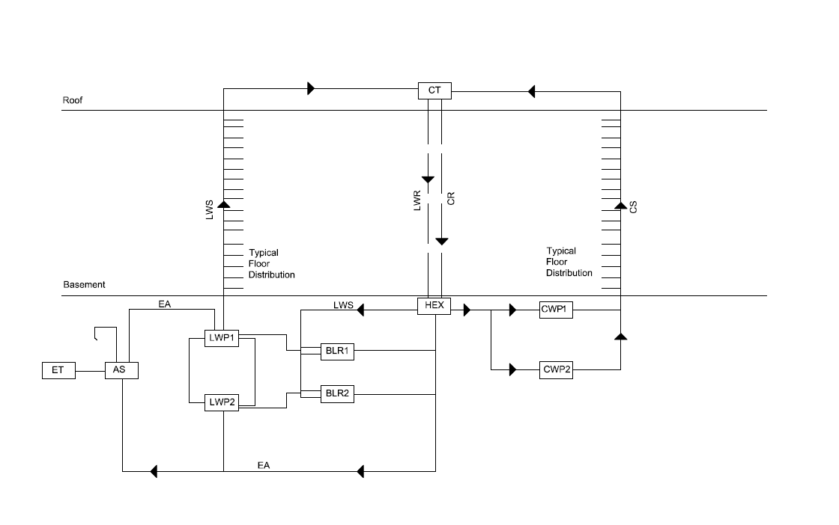
Space | ASHRAE Outdoor Airflow (cfm) | As Designed Outdoor Airflow (cfm) | Requires Redesign
Common Corridor | 933 | 5250
Stairwells | 346 | 3200
Main Entry Lobby | 42 | 570
Stair Lobby | 81 | 150
Elect Equip Room | 48 | 0 | YES
Bsmt Machine Room | 96 | 0 | YES
Elevator Machine Room | 150 | 0 | YES
Boiler Room | 96 | 0 | YES
Fire Pump Room | 96 | 0 | YES
Generator Room | 96 | 0 | YES
Dwelling Units 2nd Floor | 1641 | 1156 | YES
Dwelling Units 3-14 Floors | 17504 | 8580 | YES
Dwelling Units 15-16 Floors | 2217 | 3107
Fitness Center | 516 | 500 | YES
Retail Sales | 365 | 500
Parking Garage | 2070 | 0 | YES
Schedule
Building Overview
Existing Mechanical System
Mechanical Depth Design
Demand Control Ventilation
Mechanical Design Alternatives
Energy & Cost Analyses
Breadth 1 – Photovoltaic Array Study
Breadth 2 – CM Study
Conclusions
Acknowledgements
Laura Pica – Mechanical Option - Adviser – Stephen Treado

Slide 6
Schedule
Monthly Utility Usage
Month | Electric (kW) | Gas (therms) | Water (gal)
1 | 722 | 36776 | 16
2 | 717 | 35939 | 13
3 | 722 | 26060 | 17
4 | 849 | 15040 | 104
5 | 839 | 4558 | 263
6 | 845 | 1307 | 411
7 | 846 | 46 | 509
8 | 844 | 1717 | 350
9 | 839 | 4782 | 238
10 | 842 | 17417 | 96
11 | 749 | 20845 | 83
12 | 726 | 33222 | 17
TOTAL | 9540 | 197709 | 2117
Typical High Rise Apartment |  |  |  | River Vue Apartments
occupancy sqft/person |  |  |  | occupancy sqft/person
Lo | Av | Hi
325 | 175 | 100 |  |  | 200
lights watts/sqft |  |  |  | lights watts/sqft
Lo | Av | Hi
1 | 2 | 4 |  |  | 1
refrigeration sqft/ton |  |  |  | refrigeration sqft/ton
Lo | Av | Hi
450 | 400 | 350 |  |  | 90
supply air rate ( east-south-west) cfm/sqft |  |  |  | supply air rate ( east-south-west) cfm/sqft
Lo | Av | Hi
0.8 | 1.2 | 1.7 |  |  | 0.63
supply air rate (north) cfm/sqft |  |  |  | supply air rate (north) cfm/sqft
Lo | Av | Hi
0.5 | 0.8 | 1.3 |  |  | 0.63
Building Overview
Existing Mechanical System
Mechanical Depth Design
Demand Control Ventilation
Mechanical Design Alternatives
Energy & Cost Analyses
Breadth 1 – Photovoltaic Array Study
Breadth 2 – CM Study
Conclusions
Acknowledgements
Laura Pica – Mechanical Option - Adviser – Stephen Treado

Slide 7
Schedule
AHU Sizing Load Calculations
Building Overview
Lighting
Existing Mechanical System
Equipment
Mechanical Depth Design
Occupancy
Demand Control Ventilation
Solar Gain
Mechanical Design Alternatives
Energy & Cost Analyses
Breadth 1 – Photovoltaic Array Study
LOADS (Btu/h)
lighting | equipment | occupancy | solar | TOTAL Btu/h | TOTAL cfm
318096 | 7278258 | 352800 | 948365 | 8.90E+06 | 411922
Breadth 2 – CM Study
Conclusions
Acknowledgements
Need for energy conservation
Laura Pica – Mechanical Option - Adviser – Stephen Treado

Slide 8
Schedule
Demand Control Ventilation
Building Overview
Existing Mechanical System
Mechanical Depth Design
Demand Control Ventilation
Mechanical Design Alternatives
Energy & Cost Analyses
Breadth 1 – Photovoltaic Array Study
Breadth 2 – CM Study
Conclusions
Acknowledgements
c(t+∆t) = c(t) * e^(-n*∆t) + (cb + (N*q)/(n*V)) * (1-e^(-n*∆t)
Laura Pica – Mechanical Option - Adviser – Stephen Treado

Slide 9
Schedule
Building Overview
Existing Mechanical System
Mechanical Depth Design
Demand Control Ventilation
Mechanical Design Alternatives
Energy & Cost Analyses
Breadth 1 – Photovoltaic Array Study
Breadth 2 – CM Study
Conclusions
Acknowledgements
Laura Pica – Mechanical Option - Adviser – Stephen Treado

Slide 10
Schedule
Contaminant Calculations
Building Overview
Contaminant Differential (Ceq) = Co + (N/Vo)
Existing Mechanical System
Vo = outdoor airflow rate per person
N = CO2 rate per person
Co = CO2 concentration outside
Mechanical Depth Design
Demand Control Ventilation
Mechanical Design Alternatives
Assumptions:
15 cfm/person
700 ppm
1.2 MET level means N= 0.0106 cfm
Co = 400 ppm
Energy & Cost Analyses
Breadth 1 – Photovoltaic Array Study
Breadth 2 – CM Study
Conclusions
MET =1.2 and 15 cfm of outside airflow, the expected CO2 concentration will be about 0.13 percent
Acknowledgements
Ceq = 1107 ppm differential
Laura Pica – Mechanical Option - Adviser – Stephen Treado

Slide 11
Schedule
Telair Ventostate 8000 series sensors
Building Overview
Existing Mechanical System
accurate within 3% and can detect 400-1250 ppm of CO2
Mechanical Depth Design
CO2 detection between 2-3 minutes
Demand Control Ventilation
Mechanical Design Alternatives
Control Logic
Energy & Cost Analyses
one sensor per floor located in return air duct
Breadth 1 – Photovoltaic Array Study
supply air fan VFD to start when CO2 concentration reaches 1170 ppm or more
Breadth 2 – CM Study
Conclusions
*See final report for full descriptions of control logic and sequence of operation
Acknowledgements
Laura Pica – Mechanical Option - Adviser – Stephen Treado

Slide 12
Schedule
Building Overview
Design alternatives studied include:
Existing Mechanical System
Base AHU
Mechanical Depth Design
AHU w/ DCV
AHU w/ DCV and Economizer
Demand Control Ventilation
AHU w/ DCV and 1 Stage of Energy Recovery via Fixed Plate HX (OA Preconditioning)
Mechanical Design Alternatives
Energy & Cost Analyses
AHU w/ DCV and 2 Stages of Energy Recovery: Fixed Plate HX & Runaround Coil Loop
Breadth 1 – Photovoltaic Array Study
Breadth 2 – CM Study
Conclusions
Acknowledgements
Laura Pica – Mechanical Option - Adviser – Stephen Treado

Slide 13
Schedule
Building Overview
Existing Mechanical System
Mechanical Depth Design
Demand Control Ventilation
Mechanical Design Alternatives
Energy & Cost Analyses
Breadth 1 – Photovoltaic Array Study
Breadth 2 – CM Study
Conclusions
Acknowledgements
Laura Pica – Mechanical Option - Adviser – Stephen Treado

Slide 14
Schedule
Capital Cost
Building Overview
Existing Mechanical System
Mechanical Depth Design
Demand Control Ventilation
Mechanical Design Alternatives
Energy & Cost Analyses
Breadth 1 – Photovoltaic Array Study
Breadth 2 – CM Study
Conclusions
Acknowledgements
Laura Pica – Mechanical Option - Adviser – Stephen Treado

Slide 15
Schedule
System Selection
Airflow | 169,033 cfm
Coil Size | 434 tons
Total Btu/h | 8.9MBtu/h
Annual CO2 Emissions | 20,981,096 lbm/yr
Capital Cost | $363,600
20 Year Life Cycle Cost | $16.9 Million
Building Overview
Existing Mechanical System
Mechanical Depth Design
Demand Control Ventilation
Mechanical Design Alternatives
AHU with DCV and Economizer
Energy & Cost Analyses
Success measured with:
Breadth 1 – Photovoltaic Array Study
Occupant comfort
Breadth 2 – CM Study
Conclusions
Reduced energy use and emissions with control strategy
Acknowledgements
Minimum ventilation requirements met
Laura Pica – Mechanical Option - Adviser – Stephen Treado

Slide 16
Schedule
Building Overview
Existing Mechanical System
Mechanical Depth Design
Demand Control Ventilation
Mechanical Design Alternatives
Energy & Cost Analyses
Breadth 1 – Photovoltaic Array Study
Breadth 2 – CM Study
Conclusions
Acknowledgements
Laura Pica – Mechanical Option - Adviser – Stephen Treado

Slide 17
Schedule
Building Overview
Existing Mechanical System
Mechanical Depth Design
Size | Capacity | Throw | NC | Pressure Drop
2x12 sill grille | 62 cfm | 9.45 feet | 20 | 0.073 in wg
Demand Control Ventilation
Mechanical Design Alternatives
Energy & Cost Analyses
Breadth 1 – Photovoltaic Array Study
Breadth 2 – CM Study
Conclusions
Acknowledgements
Laura Pica – Mechanical Option - Adviser – Stephen Treado

Slide 18
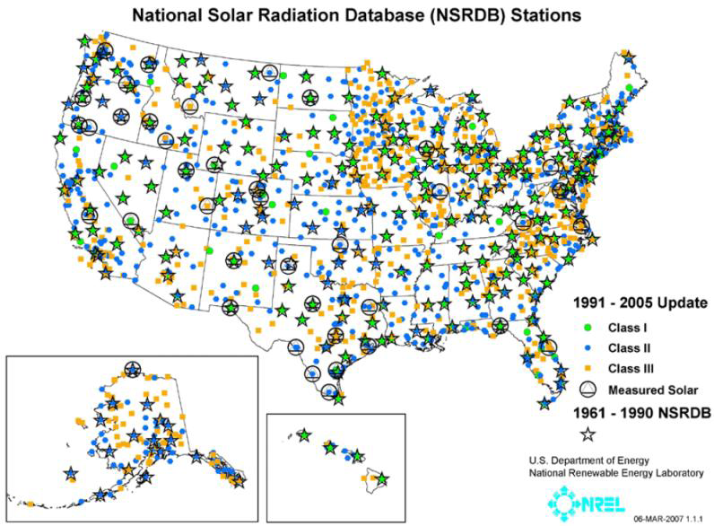
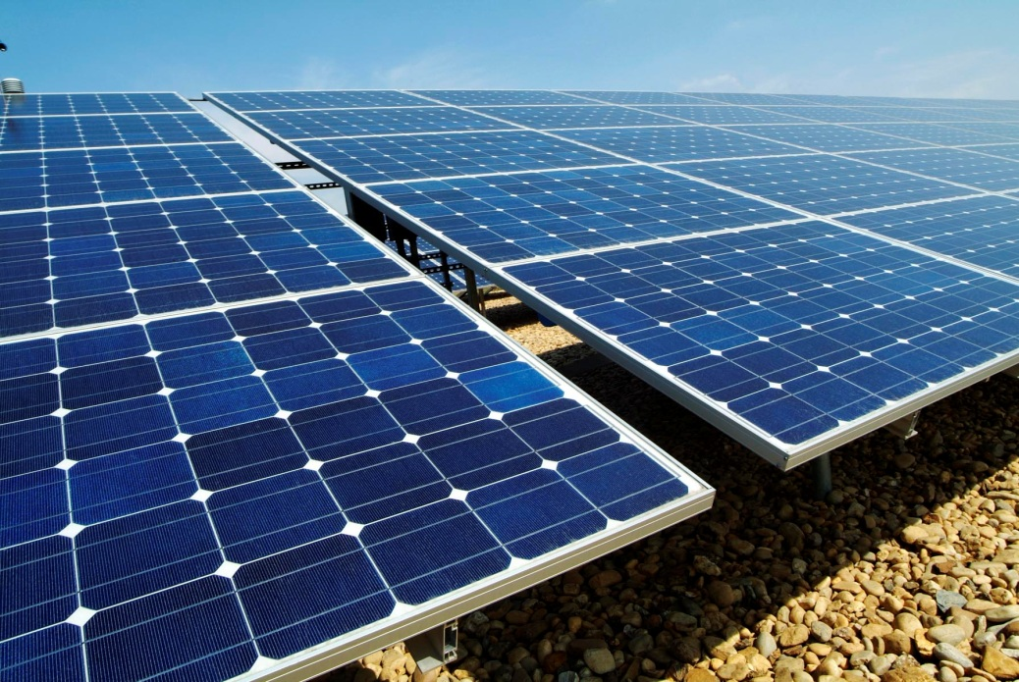
Schedule
Available Solar Radiation
5500 sq. ft. of available space
Building Overview
Existing Mechanical System
β | Monthly Electric Output
0 | 1.401E+18
5 | 1.389E+22
10 | 9.904E+20
15 | 4.487E+20
20 | 1.722E+20
25 | 3.564E+20
30 | 1.177E+24
35 | 1.044E+21
40 | 6.104E+20
45 | 3.497E+20
Mechanical Depth Design
Demand Control Ventilation
Mechanical Design Alternatives
Energy & Cost Analyses
Breadth 1 – Photovoltaic Array Study
Breadth 2 – CM Study
Conclusions
www.rredc.nrel.gov/solar_data
Acknowledgements
http://gerardribas.com/wp-content/uploads/2011/05/Photovoltaic-Pannles6.jpg
Laura Pica – Mechanical Option - Adviser – Stephen Treado
Photo taken by Laura Pica August 2011

Slide 19
Schedule
Building Overview
Existing Mechanical System
Energy Analysis
Mechanical Depth Design
Windows modeled with improved U-value to represent shading
Demand Control Ventilation
Mechanical Design Alternatives
Sensible solar gain reduction of 243,549 Btu/h
Energy & Cost Analyses
(10% of total sensible load)
Breadth 1 – Photovoltaic Array Study
Breadth 2 – CM Study
Conclusions
Acknowledgements
Laura Pica – Mechanical Option - Adviser – Stephen Treado

Slide 20
Schedule
Internal Shading Analysis
# Shades | volts | amps | VA | PF | Watts | Full load amps
1 | 120 | 20 | 2400 | 1 | 2400 | 12
400 | 120 | 8000 | 960000 | 1 | 960000 | 4624
Building Overview
Existing Mechanical System
Mechanical Depth Design
Demand Control Ventilation
Mechanical Design Alternatives
Energy & Cost Analyses
# Shades | Shade (kW) requirement per year | Annual PV Array (kW) output | ∆ (PV Output-Shading Requirement) | Annual Mechanical System Requirement (kW) | Mech Syst Need - PV Power Available
1 | 2102.4 | 30872 | 28770 | 9491826 | 9460954
 |  |  |  |  | 0
400 | 840960 |  | -810088 | 9491826 | 9460954 | 0.33%
http://mechosystems.com/UrbanShade/
Breadth 1 – Photovoltaic Array Study
Breadth 2 – CM Study
Conclusions
Acknowledgements
Laura Pica – Mechanical Option - Adviser – Stephen Treado
http://mechosystems.com/UrbanShade/

Slide 21
Schedule
Photovoltaic Array Study
Date | Year | Capital | Other Mat. |  | Elect. Escalation | Elect. Value
2011 | 1 | $ 1,473,591 | $ 100 |  | 1.00 | $ 64,461
2012 | 2 | $ - | $ 100 |  | 0.96 | $ 61,883
2013 | 3 | $ - | $ 100 |  | 0.93 | $ 59,949
2014 | 4 | $ - | $ 100 |  | 0.91 | $ 58,660
2015 | 5 | $ - | $ 100 |  | 0.91 | $ 58,660
2016 | 6 | $ - | $ 100 |  | 0.90 | $ 58,015
2017 | 7 | $ - | $ 100 |  | 0.90 | $ 58,015
2018 | 8 | $ - | $ 100 |  | 0.90 | $ 58,015
2019 | 9 | $ - | $ 100 |  | 0.91 | $ 58,660
2020 | 10 | $ - | $ 100 |  | 0.92 | $ 59,304
2021 | 11 | $ - | $ 100 |  | 0.93 | $ 59,949
2022 | 12 | $ - | $ 100 |  | 0.94 | $ 60,594
2023 | 13 | $ - | $ 100 |  | 0.94 | $ 60,594
2024 | 14 | $ - | $ 100 |  | 0.94 | $ 60,594
2025 | 15 | $ - | $ 100 |  | 0.94 | $ 60,594
2026 | 16 | $ - | $ 100 |  | 0.94 | $ 60,594
2027 | 17 | $ - | $ 100 |  | 0.94 | $ 60,594
2028 | 18 | $ - | $ 100 |  | 0.94 | $ 60,594
2029 | 19 | $ - | $ 100 |  | 0.93 | $ 59,949
2030 | 20 | $ - | $ 100 |  | 0.93 | $ 59,949
 |  |  | Net Present Value |  |  | $ 953,086
Building Overview
Original Photovoltaic TOTAL |  |  | $ 712,273.54
Solar Funding | PA Federal Investment Tax Credit | 30% of total installation cost | $ 213,682.06
 | West Penn Power Sustainable Energy Fund | one time grant | $ 25,000.00
 | New Photovoltaic TOTAL |  | $ 473,591.48
Existing Mechanical System
Mechanical Depth Design
Demand Control Ventilation
Mechanical Design Alternatives
Energy & Cost Analyses
Breadth 1 – Photovoltaic Array Study
Breadth 2 – CM Study
simple payback period = 26.6 years
Conclusions
Acknowledgements
Laura Pica – Mechanical Option - Adviser – Stephen Treado

Slide 22
Schedule
Category | Cost for Equipment & Materials | Total installation hours | Total installation days
New Mech System | $ 865,728.62 | 18306 | 763
Old Mechanical System | $ 1,371,508.55 | 24812 | 1034
Mech System Cost Difference | $ 505,779.92 savings | 6506 | 271
Category | Total Labor Cost
New Mech System | $ 15,610.64
Old Mechanical System | $ 3,323.81
Mech System Cost Difference | $ (12,286.83)
Building Overview
Existing Mechanical System
Mechanical Depth Design
Demand Control Ventilation
Mechanical Design Alternatives
Energy & Cost Analyses
Breadth 1 – Photovoltaic Array Study
Breadth 2 – CM Study
Conclusions
Acknowledgements
Laura Pica – Mechanical Option - Adviser – Stephen Treado

Slide 23
Schedule
Category | Cost for Equipment & Materials | Total installation hours | Total Labor Cost
New Mech System with Photovoltaic and Shading Systems TOTAL | $ 2,578002.16 | 18911 | $ 17,128.94
Old Mechanical System | $ 1,371,508.55 | 24812 | $ 3,323.81
Overall System Difference | $ (1,206,493.62) | 5901 | $ (13,805.13)
Building Overview
Existing Mechanical System
Mechanical Depth Design
Demand Control Ventilation
Type of Certification | Points Range
Certified | 26-32
Silver | 33-38
Gold | 39-51
Platinum | 52-69
Mechanical Design Alternatives
www.usgbc.org
Energy & Cost Analyses
Breadth 1 – Photovoltaic Array Study
Breadth 2 – CM Study
Conclusions
Acknowledgements
Laura Pica – Mechanical Option - Adviser – Stephen Treado

Slide 24
Schedule
 | Original Schedule
 | Duration (days) | Start | Finish
 | 840 | 7/25/2011 | 8/31/2012
Building Overview
Existing Mechanical System
Mechanical Depth Design
Project Schedule
 | Original Schedule |  |  |  | Adjusted Schedule
 | Duration | Start | Finish |  | Duration | Decrease in Time
TOTAL | 840 | 7/25/2011 | 8/31/2012 |  | 640 | 24%
MEP Rough In | 465 | 7/25/2011 | 2/10/2012 |  | 340 | 27%
MEP Finishes | 250 | 11/21/2011 | 7/27/2012 |  | 190 | 24%
Punch list & Inspections | 125 | 2/27/2012 | 8/31/2012 |  | 110 | 12%
Demand Control Ventilation
Mechanical Design Alternatives
Energy & Cost Analyses
 | Adjusted Schedule
 | Duration | Decrease in Time
 | 640 | 24%
Breadth 1 – Photovoltaic Array Study
Breadth 2 – CM Study
Conclusions
Acknowledgements
Laura Pica – Mechanical Option - Adviser – Stephen Treado

Slide 25
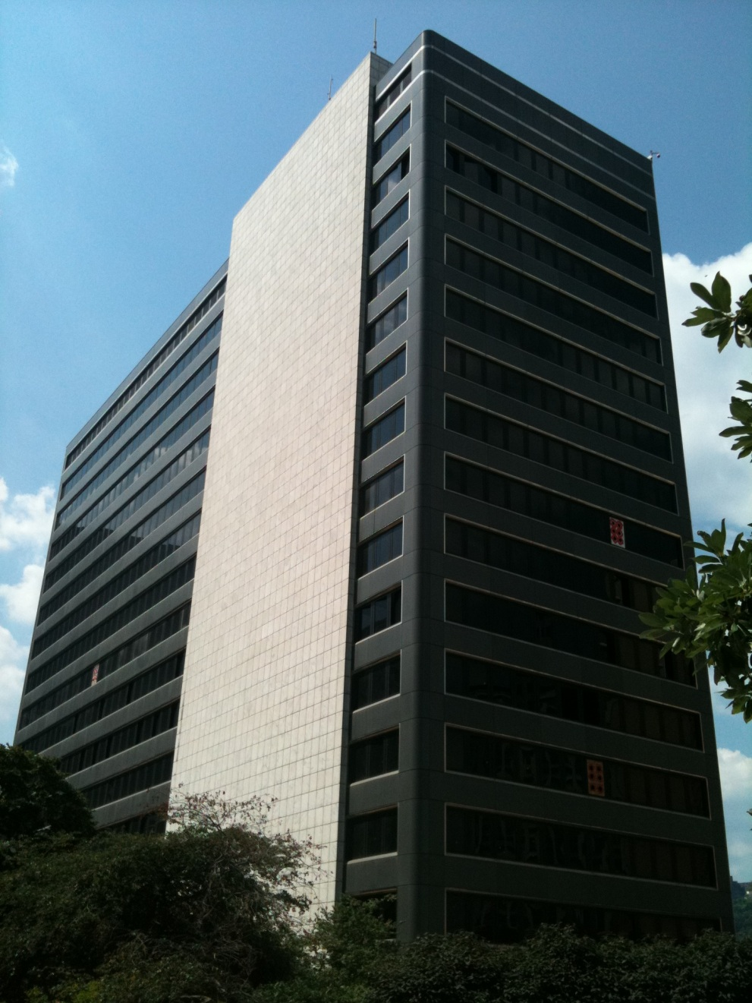
Schedule
Conclusions
Building Overview
Recommended larger AHU with Demand Control Ventilation
Existing Mechanical System
Mechanical Depth Design
Increased occupant comfort
Minimum ventilation requirements met
Demand Control Ventilation
Decreased capital cost
Mechanical Design Alternatives
Decreased construction schedule
Energy & Cost Analyses
Breadth 1 – Photovoltaic Array Study
Photovoltaic array and internal shading not recommended
Breadth 2 – CM Study
Conclusions
Next Analysis – the use of solar thermal collectors and storage to assist existing system
Acknowledgements
Laura Pica – Mechanical Option - Adviser – Stephen Treado
Photo taken by Laura Pica August 2011

Slide 26
Acknowledgements
My adviser, Stephen Treado, for his help in editing my technical reports and providing professional consulting
All other Department of Architectural Engineering faculty for their passion for teaching, continued support and encouragement
All AE Mentors and Practitioners from the “Mentoring Center” for their valuable design advice
Kevin Ludwick, Turner Project Manager for supplying design documents and construction data
And most importantly, my friends and family for their support throughout my senior year. I could have never finished this project without you!

Slide 27
Thank You
Questions?

Slide 28
Appendix

Slide 29
Room No | Space Type | Area (Az) | OA Rate per person (Rp) | OA Rate (cfm) | OA Rate (cfm) | (CFM) | Btu/h
B-10 | lobby | 100 | 5 | 25 | 6 | 31 | 1.435
Mechanical Depth Design
Load Calculations
LOADS (Btu/h)
lighting | equipment | occupancy | solar | TOTAL Btu/h | TOTAL cfm
318096 | 7278258 | 352800 | 948365 | 8.90E+06 | 411922
Room No | Space Type | Area (Az) | (Watts) | Density (W/sqft) | Btu/h
B-10 | lobby | 100 | 256 | 2.560 | 874
Equipment | Quantity | BTU/h per unit | Watts per unit |  | TOTAL Btu/h
dishwasher | 199 | 800 | 234 |  | 159200
Room No | Space Type | Expected # of occupants | occupant load (Btu/h) | CFM
B-10 | lobby | 5 | 1750 | 81

Slide 30
Category | Equipment | Quantity | Cost Per Item (Inc. O&P) | Total Cost
Mechanical System Design Alternative | AHU – VAV for 100,000 cfm, not incl duct & accessories | 2 | $ 161,000.00 | $ 322,000.00
 | DCV Direct-Digital CO2 Detector System, incl panel & sensor | 1 | $ 1,650.00 | $ 1,650.00
 | DCV sensor | 200 | $ 950.00 | $ 190,000.00
 | DCV Wiring (ft) | 212 | $ 50.00 | $ 10,600.00
 | Economizer Add-on | 1 | $ 25,000.00 | $ 25,000.00
 | supply duct (lb) – 20” | 16299.75 | $ 5.67 | $ 92,338.08
 | supply duct (lb) – 10” | 16268.1 | $ 2.83 | $ 45,989.92
 | return duct (lb) – 20” | 24604 | $ 5.67 | $ 139,382.37
 | supply elbows | 225 | $ 18.55 | $4173.75
 | return elbows | 255 | $ 37.00 | $9435
 | supply transitions | 60 | $35 | $2100
 | diffusers | 225 | $65.5 | $14737.5
 | modulating dampers for AHU | 2 | $161 | $322
 | TOTAL |  |  | $ 857,728.62
Category | Equipment | Crew Size | $ Per crew member | Total Labor $ | Labor Hours per unit | Total installation hours
Mechanical System Design Alternative | AHU – VAV for 100,000 cfm, not incl duct & accessories | 1 | $ 14,400.00 | $ 14,400.00 | 290 | 580
 | DCV Direct-Digital CO2 Detector System, incl panel & sensor | 2 | $ 104.00 | $ 208.00 | 2 | 2
 | DCV sensor | 2 | $ 57.00 | $ 114.00 | 1.1 | 220
 | DCV Wiring (ft) | 1 | $ 16.00 | $ 16.00 | 0.2 | 42
 | Economizer Add-on | 1 | $ 590.00 | $ 590.00 | 13 | 13
 | supply duct (lb) – 20” | 2 | $ 16.90 | $ 33.80 | 0.369 | 6015
 | supply duct (lb) – 10” | 2 | $ 4.42 | $ 8.84 | 0.1 | 1627
 | return duct (lb) – 20” | 2 | $ 16.90 | $ 33.80 | 0.369 | 9079
 | supply elbows | 2 | $ 10.00 | $ 20.00 | 0.5 | 113
 | return elbows | 2 | $ 10.00 | $ 20.00 | 0.5 | 128
 | supply transitions | 2 | $ 10.00 | $ 20.00 | 0.5 | 30
 | diffusers | 4 | $ 12.30 | $ 49.20 | 0.25 | 56
 | modulating dampers for AHU | 1 | $ 49.00 | $ 49.00 | 1 | 2
 | TOTAL |  |  | $ 15,562.64 |  | 17906
Breadth 2 – CM Study
Mechanical System Takeoff

Slide 31
Breadth 2 – CM Study
Electrical Takeoff
Category | Equipment | Crew Size | $ Per crew member | Total Labor $ | Labor Hours per unit | Total installation hours
Photovoltaic Array | photovoltaic panel kit | 2 | $ 25.00 | $ 50.00 | 0.75 | 70.5
 | additional wiring (ft) | 2 | $ 16.00 | $ 32.00 | 1 | 212
 | conduit | 2 | $ 9.40 | $ 18.80 | 0.2 | 42.4
 | conduit cutting/drilling | 1 | $ 114.00 | $ 114.00 | 2.4 | 153.6
 | grounding electrode | 1 | $ 68.50 | $ 68.50 | 1.45 | 1.45
 | circiut breaker | 1 | $ 1,175.00 | $ 1,175.00 | 25 | 25
 | internal shade | 4 | $ 15.00 | $ 60.00 | 0.25 | 100
 | shade motor | 4 | $ 15.00 | $ 60.00 | 0.2 | 80
 | TOTAL |  |  | $ 1,578.30 |  | 685
Category | Equipment | Quantity | Cost Per Item (Inc O&P) | Total Cost
Photovoltaic Array | photovoltaic panel kit | 94 | $ 6,790.91 | $ 638,345.54
 | additional wiring (ft) | 212 | $ 140.00 | $ 29,680.00
 | conduit | 212 | $ 44.00 | $ 9,328.00
 | conduit cutting/drilling | 64 | $ 200.00 | $ 12,800.00
 | grounding electrode | 1 | $ 120.00 | $ 120.00
 | circiut breaker | 1 | $ 22,000.00 | $ 22,000.00
 | internal shade & motor | 400 | $ 2500 | $ 1,000,000.00
 | TOTAL |  |  | $ 1,712,273.54

Slide 32
Breadth 2 – CM Study
Project Schedule
 | Original Schedule |  |  |  | Adjusted Schedule
Zone | Duration | Start | Finish |  | Duration | Decrease in Time
TOTAL | 840 | 7/25/2011 | 8/31/2012 |  | 640 | 24%
MEP Rough In | 465 | 7/25/2011 | 2/10/2012 |  | 340 | 27%
Elevator Lobbies & Stair Towers Rough In | 100 | 8/15/2011 | 12/9/2011 |  | 85
Basement and Level 1 Underground Rough In | 80 | 10/24/2011 | 2/10/2012 |  | 70
Level 2, 3, 4, 5 Rough In | 60 | 7/25/2011 | 10/14/2011 |  | 40
Level 6 & 7 Rough In | 30 | 8/1/2011 | 9/9/2011 |  | 15
Level 8 & 9 Rough In | 30 | 8/22/2011 | 9/30/2011 |  | 15
Level 10 & 11 Rough In | 30 | 9/12/2011 | 10/21/2011 |  | 15
Level 12 & 13 Rough In | 30 | 10/3/2011 | 11/11/2011 |  | 15
Level 14, 15 & 16 Rough In | 45 | 10/24/2011 | 12/23/2011 |  | 30
Penthouse and Roof Rough In | 60 | 8/8/2011 | 10/28/2011 |  | 55
MEP Finishes | 250 | 11/21/2011 | 7/27/2012 |  | 190 | 24%
Elevator Lobbies & Stair Towers | 60 | 11/21/2011 | 2/10/2012 |  | 45
Basement and Level 1 Underground | 20 | 1/30/2012 | 2/24/2012 |  | 15
Level 2, 3, 4, 5 | 60 | 11/28/2011 | 2/17/2012 |  | 45
Level 6 & 7 | 20 | 2/27/2012 | 3/23/2012 |  | 15
Level 8 & 9 | 20 | 3/19/2012 | 4/13/2012 |  | 15
Level 10 & 11 | 20 | 4/30/2012 | 5/25/2012 |  | 15
Level 12 & 13 | 20 | 5/28/2012 | 6/22/2012 |  | 15
Level 14, 15 & 16 | 30 | 6/18/2012 | 7/27/2012 |  | 25
Punch list & Inspections | 125 | 2/27/2012 | 8/31/2012 |  | 110 | 12%
Basement and Level 1, 2, 3, 4, 5 | 20 | 2/27/2012 | 3/23/2012 |  | 18
Level 6 & 7 | 20 | 3/26/2012 | 4/20/2012 |  | 18
Level 8 & 9 | 20 | 4/23/2012 | 5/18/2012 |  | 18
Level 10 & 11 | 20 | 5/28/2012 | 6/22/2012 |  | 18
Level 12 & 13 | 20 | 7/2/2012 | 7/27/2012 |  | 18
Level 14, 15 & 16 | 25 | 7/30/2012 | 8/31/2012 |  | 20
Schedule Changes

